Slide 1
FIFA Case Study Report
EDA and Stats

Slide 2
Overview
This is a Statistics and EDA project designed to train and test us on basic Data Exploratory and Statistical techniques used in the industry today. Apart from bringing you to speed with basic descriptive and inferential methods, we will also deep dive into a dataset and perform thorough cleaning and analysis in order to draw useful business insights from the data. This will expose us to what data scientists do most often–Exploratory Data Analysis.

Slide 3
Eda part
The following are the BMI of 50 young adults 17.5 18.0 36.8 31.7 31.7 17.3 24.3 47.7 38.5 17.0 23.7 16.5 25.1 17.4 18.0 37.6 19.7 21.4 28.6 21.6 19.3 20.0 16.9 25.2 19.8 25.0 17.2 20.4 20.1 29.1 19.1 25.2 23.2 25.9 24.0 41.7 24.0 16.8 26.8 31.4 16.9 17.2 24.1 35.2 19.1 22.9 18.2 25.4 35.4 25.5

Slide 4
Goals
Using the core statistical theoretical concepts and knowledge to solve real time problem statements.
Visualize a real time industry scenario where one can use these statistical concepts.
Detailed data analysis and number crunching using statistics
Exhaustive report building using EDA and visualization techniques to help the business take decisions using insights from the data

Slide 5
Data description
ID,unique id for every player
Name,name
Age,age
Photo,url to the player's photo
Nationality,nationality
Flag,url to players's country flag
Overall,overall rating
Potential,potential rating
Club,current club
Club Logo,url to club logo
Value,current market value
Wage,current wage

Slide 6
Data description
Preferred Foot,left/right
International Reputation,rating on scale of 5
Weak Foot,rating on scale of 5
Skill Moves,rating on scale of 5
Work Rate,attack work rate/defence work rate
Body Type,body type of player
Position,position on the pitch
Jersey Number,jersey number
Joined,joined date

Slide 7
Data description
Loaned From,club name if applicable
Contract Valid Until,contract end date
Height,height of the player
Weight,weight of the player
Crossing,rating on scale of 100
Finishing,rating on scale of 100
HeadingAccuracy,rating on scale of 100
ShortPassing,rating on scale of 100
Volleys,rating on scale of 100

Slide 8
Data description
Dribbling,rating on scale of 100
Curve,rating on scale of 100
FKAccuracy,rating on scale of 100
LongPassing,rating on scale of 100
BallControl,rating on scale of 100
Acceleration,rating on scale of 100
SprintSpeed,rating on scale of 100
Agility,rating on scale of 100
Reactions,rating on scale of 100\
Balance,rating on scale of 100

Slide 9
Data description
ShotPower,rating on scale of 100
Jumping,rating on scale of 100
Stamina,rating on scale of 100
Strength,rating on scale of 100
LongShots,rating on scale of 100
Aggression,rating on scale of 100
Interceptions,rating on scale of 100
Positioning,rating on scale of 100
Vision,rating on scale of 100
Penalties,rating on scale of 100

Slide 10
Composure,rating on scale of 100
Marking,rating on scale of 100
StandingTackle,rating on scale of 100
SlidingTackle,rating on scale of 100
GKDiving,rating on scale of 100
GKHandling,rating on scale of 100
GKKicking,rating on scale of 100
GKPositioning,rating on scale of 100
GKReflexes,rating on scale of 100
Release Clause,release clause value

Slide 11
Problem Solving steps
Read the questions carefully and understand them.
Import the necessary libraries and read the data.
Drop any columns that you deem unnecessary for analysis.
Check the duplicate records and do appropriate treatments.
Check the variation of the features. If you are performing variance and standard deviation. Kindly explain why the variances of the variables are higher than the standard deviation. Also, explain which one tells the exact variation of the features. Based on this analysis decide which feature is not needed.
Check for missing values and do imputations where necessary.

Slide 12
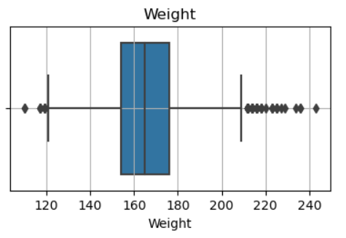
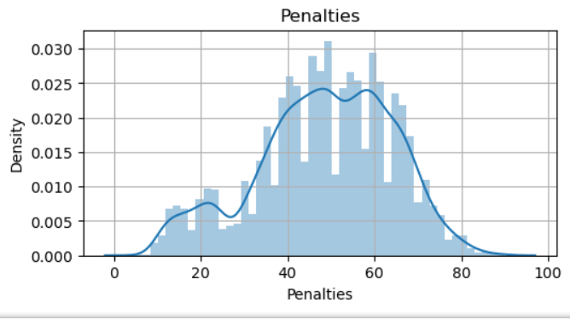
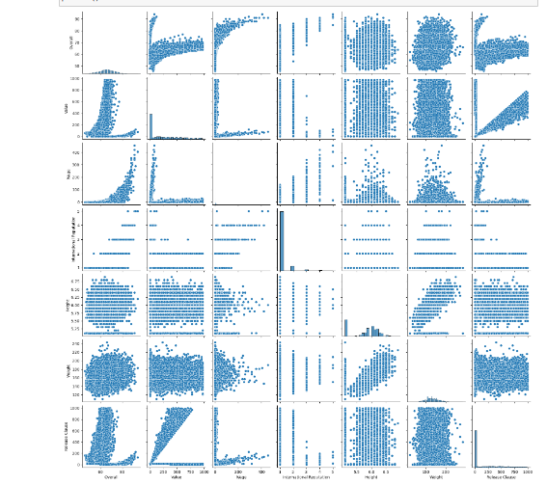
Using Visualization

Slide 13
Problem solving
Data Collection: Imported data into python using libraries like ‘Pandas’ to create data frames.
Data Inspection: Checked the first few rows of the data to get an initial sense of its structure.
Data Cleaning: Handled missing values by using methods like ‘dropna()’,’fillna()’ or imputation.
Removed duplicates using ‘drop duplicates()’.
Data Visualization: Visualised the data to gain insights using libraries like ‘matplotlib', 'Seaborn’.
Data Analysis: Performed summary statistics and aggregation to understand the data better.
Hypothesis Testing: Conducted statistical tests to validate hypothesis.
Correlation Analysis: Used correlation plots to identify relationships between variables.

Slide 14
Takeaways and Conclusions
By solving the questions, we have gained knowledge regarding the following concepts: • Data Distribution
Central Tendency
Data Spread
Data Relationships
Outliers
Data Patterns • Missing Data • Data Visualizations • Data Quality • Feature Selection • Hypothesis generation • Data Preprocessing • Decision making

Slide 15
Conclusion of the project.
Exploratory data analysis and Statistics are the two crucial steps that helps us to gain a deep understanding of data, allowing us to make informed choices throughout the data analysis process and ultimately draw meaningful insights and conclusions

